Slide 1
Open House
2021 - 2022
Welcome to Northside Elementary

Slide 2
Reminders
Pirate Pride T-shirts - $12.00
Workbook fee - $16 (checks to Northside Elementary)
Please send a water bottle with your child each day. We will not use the water fountains this year. We have bottle fillers on each hallway.
All students, staff, and visitors should wear a mask when inside the building. Masks will be worn on the school bus as well.

Slide 3
Transportation Text Alerts
To receive text alerts related to Northside bus routes: Text @busnsele to 81010.
These alerts will let you know about substitute buses and late buses.

Slide 4
Arrivals/Dismissals
Arrival – students may arrive at school between 7:00 - 7:30 a.m.
Students arriving after 7:30 are considered tardy.
Early Dismissal/Checkout- If you need to check your child out early, please do so before 1:30 (Monday, Tuesday, Thursday, and Friday) and 1:00 (Wednesday).
A valid photo ID is required to check out a student.
Students must be at school 63% of the day to be counted as present.
Please send an excuse with your child after every absence. Please see page 6 of the PPSD Student/Parent Handbook.

Slide 5
Lunch Reminders
Student meals are free this year for both breakfast and lunch.
To allow for social distancing, we will rotate weekly eating in the cafeteria and your child’s classroom.
Unfortunately, we will not be allowed to have lunch guests this year.
Any treats sent to school must be store bought (no homemade goodies, please).

Slide 6
Healthy Pirates at School
Students SHOULD NOT attend school if they have any of the following: ​
Fever of 100˚ or greater; chills; nausea/vomiting; diarrhea; severe sore throat/earache/headache; persistent cough; contagious rash; pink eye. ​
Your child’s temperature will be checked upon entering the building each morning. If your child has a temperature of more than 100˚, we will contact you to come to check your child out from school.

Slide 7
Communication
Signed papers will come home weekly. Please look over these with your child, sign them, and return them to school the next day.
Planners will come home each day with your child. Please check this daily as it is one of the main ways your teacher will communicate with you.
Homework – please check the newsletter and planner each day for homework.
Please visit our school, district, and teacher websites often. You will find valuable resources and important information housed on these websites. www.pearlk12.com

Slide 8
Google Classroom
Students will be learning how to use Google Classroom while at school. In case we have to use the virtual model for school at any point during the school year, students will be familiar with using this learning system.

Slide 9
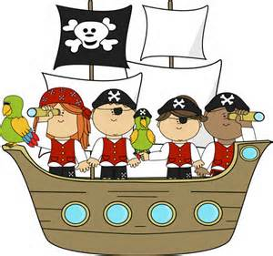
We are excited for a great year!

Slide 10
Questions?

